Slide 1
Python for Data Analys
Thibaud Trarieux DIA7

Slide 2
Summary :
- Dataset presentation and problematic
- Treatment of data
- Machine learning
- Django API
- Conclusion

Slide 3
Dataset presentation
The dataset contains 17 attributes and 2111 records, the records are labeled with the class variable Obesity_lvl, which can have the following values :
- Insufficient Weight
- Normal Weight
- Overweight Level I
- Overweight Level II
- Obesity Type I
- Obesity Type II
-Obesity Type III.
Problematic : Can we predict someone’s obesity level using the dataset ?

Slide 4
Treatment of data

Slide 5
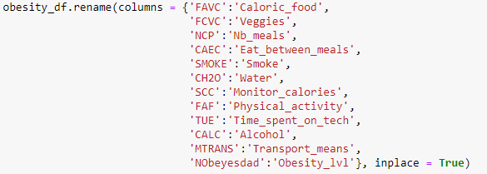
Rename columns
Firstly, let’s rename columns with clearer names.

Slide 6
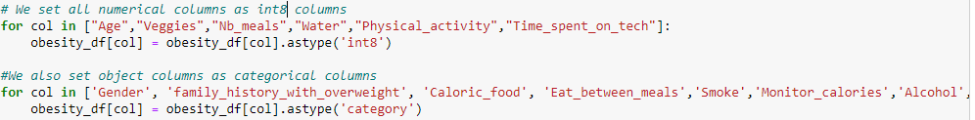
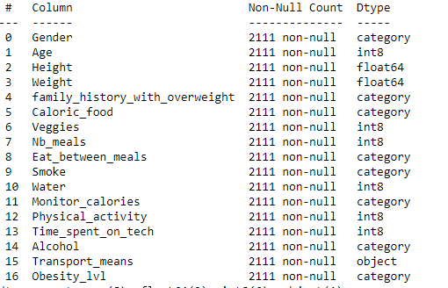
Changing data type
Now, let’s set all numerical columns as int type columns and all object columns as category type columns.
For now, we keep some columns with category type because we first want to make some visualizations in the notebook.

Slide 7
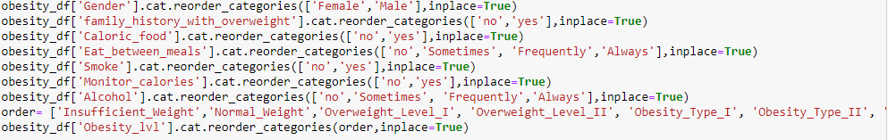
Changing categorical data into numerical data
Once we are done with visualizations, we can change categorical data into numerical data.
Firstly, we set an order for categorical columns using ‘.cat.reorder_categories’.
Once values of each categorical column are ordered, we can change it into numeric data.

Slide 8
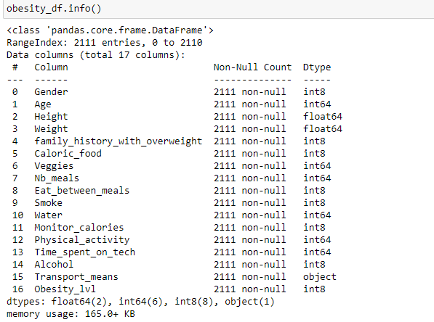
Now, all the variables are numerical, except the Transport_means column but we will deal later with it.

Slide 9
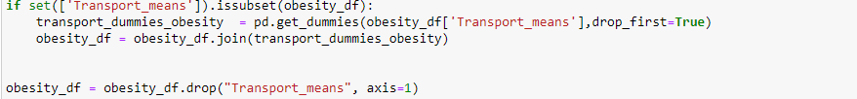
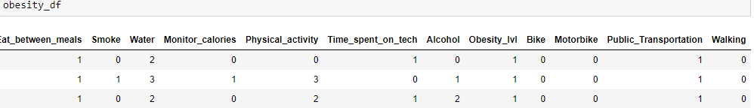
Transport_means column & Creation of new variables
Values of Transport_means columns were not orderable. So, I modified the structure of data and create new columns using ‘pd.get_dummies’.
Then, we can drop Transport_means column without loosing any information.
We have now 4 new columns : Bike, Motorbike, Public_Transportation, Walking.

Slide 10
Machine learning

Slide 11
Split of the dataset
Firstly, let's split data into training set and test set. 66% of data will be used to train the model and 33% to test the model.

Slide 12
Fitting data
Let’s fit training set to improve the accuracy of our machine learning algorithms.

Slide 13
Algorithms & GridSearch
We will use the following algorithms from sckit-learn library :
Logistic Regression
Support Vector Machines
Random Forest
KNeighborsClassifier
Gaussian Naive Bayes
For each model, we firstly use a grid seach to find the best hyperparameters. Then, we run each model with the best hyperparameters found. Finally, we add to score_models the score of each model.

Slide 14
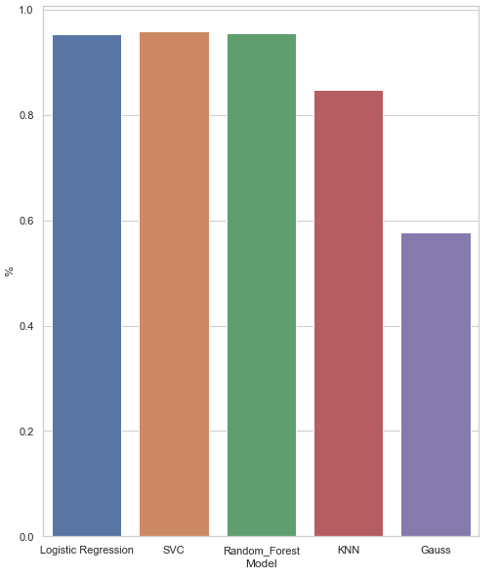
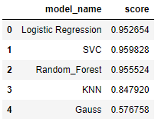
Results of
We notice that 3 models hit a really good score ( SVC, Random Forest and Logistic Regression). The best model seems to be SVC with 0.959828 of accuracy.

Slide 15
API Django

Slide 16
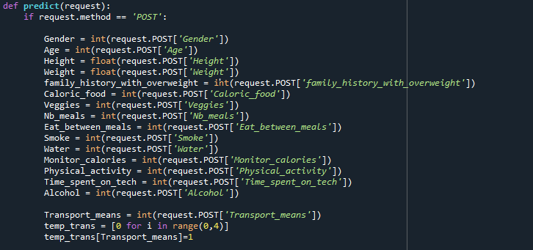
I decided to use Django to make an API. How does it work ?
Basically, we firstly we take data the user will post on the api.

Slide 17
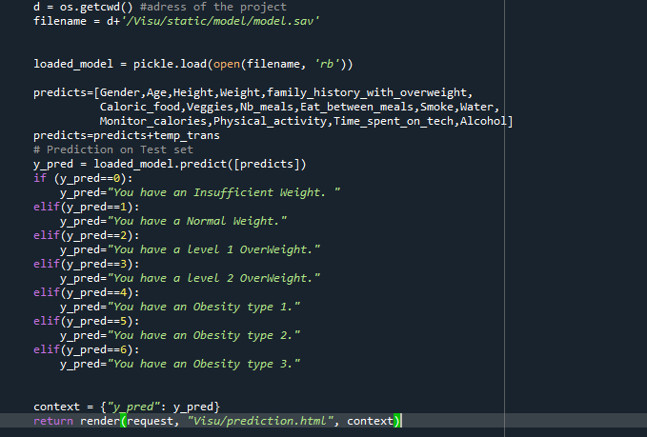
Then, we call the best model we found previously from the notebook. (SCV)
And we make the predictions on the test set.

Slide 18
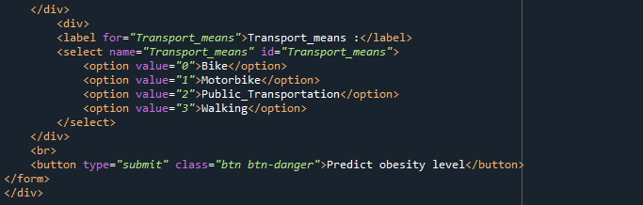
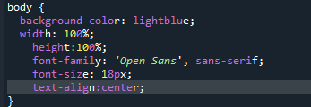
After that we must do 2 html pages. One that allows the user to enter data(index.html and one to show the results (prediction.html).
Finally, we add a style.css file to make the web page look nicer.
Piece of index.html
Prediction.html

Slide 19
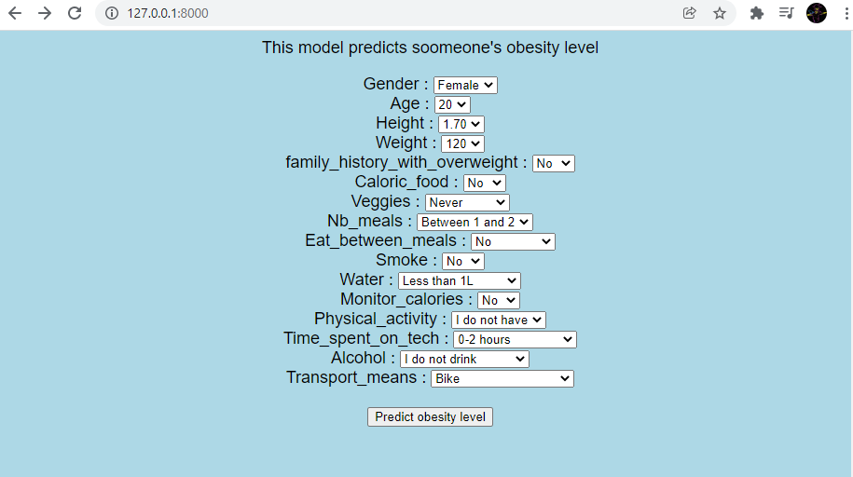
Webpage 1

Slide 20
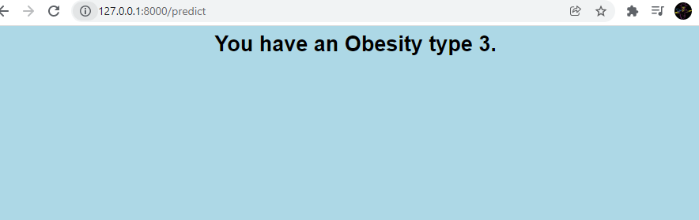
Webpage 2

Slide 21
Conclusion
Finally, the best machine learning algorithm to predict someone’s obesity level is SVC, with 0.959828 of accuracy.
Random forest, logistic regression and Knn also had a great score.
However, Gaussian algorithm was not performant, with 0.576758 of accuracy.

